Slide 1

Gun Violence & Covid 19
Pre and post stay-at-home orders

Slide 2
Presentation
Meet Our Team
Executive Summary
Objectives
Background
Methods & Results
Summary
Conclusions
Questions

Slide 3


Meet Our Team
Sophie Ban
Genesis Docena
BA in Philosophy
MA in Philosophy
9 years experience in Community College Teaching
Now a fundraising database manager
BS in Math
MAT in Math Education
7 years experience high school math
Now an Operations Research Analyst
Mom to twin boy/girl toddlers

Slide 4
Executive Summary
The purpose of this project was to explore the effect that the Covid pandemic has had on gun violence. We will answer one central question and four auxiliary questions. The scope of this project is to understand the link between the Covid pandemic and gun-violence. We will use R, Python, SQL, and Tableau and no other programs.
Data is sourced from The Gun Violence Archive, an online archive of gun violence incidents collected from over 7,500 law enforcement, media, government and commercial sources daily in an effort to provide near-real time data about the results of gun violence.

Slide 5
Business Objectives
We endeavor to answer the following questions
What effect has the Covid pandemic had on gun-violence in the US?
Do the number of incidents change before lockdown orders versus after lockdown orders?
What, if any, regional differences might there be with gun violence incidents pre and post lockdown mandates?

Slide 6
Background
There is a putative link between mental health and Covid (Javed, Sarwer, Soto, & Mashwani 2020) and at least a weak positive correlation between mental illness and gun violence (Rozel & Mulvey 2017). On the assumption that the Covid pandemic has caused increases in mental illness and mental illness is among the causes of gun violence, by transitivity of causation, we should see an uptick in gun violence post-Covid as compared to pre-Covid numbers. It turns out, this is just what we see. Further analysis of this data such as the locations, times of day, changes in policing laws in those locations, will all count towards understanding the effects of the Covid pandemic on the rate of gun violence in the US.
The scope of this project is to understand the link between the Covid pandemic and gun-violence. If there is any change in the rate of gun-violence post-Covid as compared to pre-Covid, we will only be interested in investigating whether that link might be explained in terms of increases of cases of mental illness. If no such links between mental illness and Covid can be found, we will conclude that some factor other than mental illness explains that. With one exception, we will not be interested in any further putative explanations of any found positive correlations between the Covid pandemic and gun violence in the US. The one exception will be changes in policing. If we find that changes in policing are co-occurring with changes in the rate of gun-violence, then we will consider that as a mitigating factor in our analysis.

Slide 7

Exploratory Analysis
Data Visualization with Tableau

Slide 8
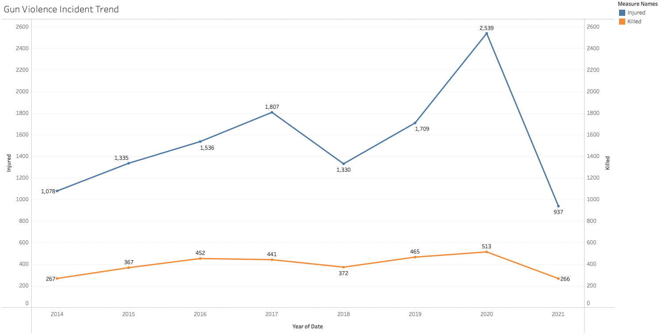
Overall trend of increasing deaths and injuries from gun violence

Slide 9
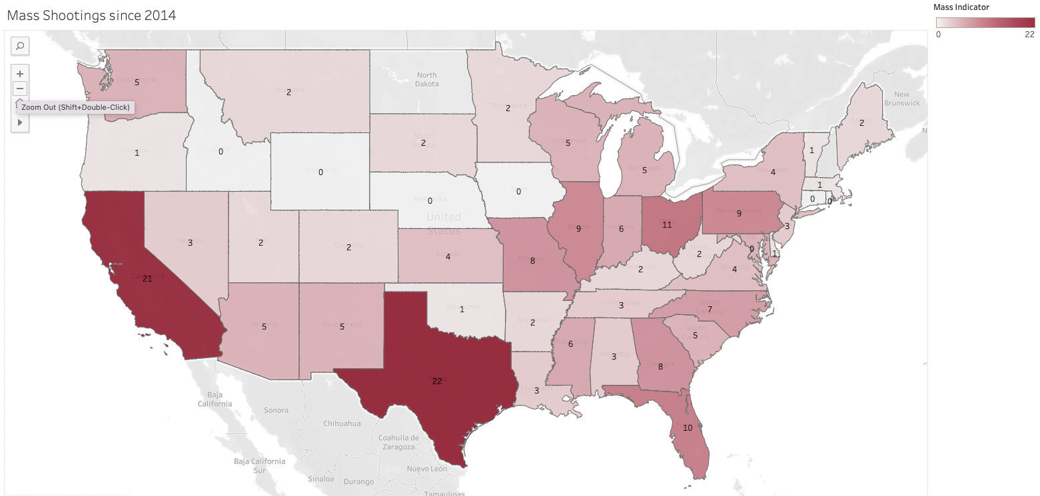
By federal definition, mass shootings are gun violence incidents with 4 or more deaths, not including the shooter.
Note: Alaska is not shown but it had 1 mass shooting since 2014.

Slide 10
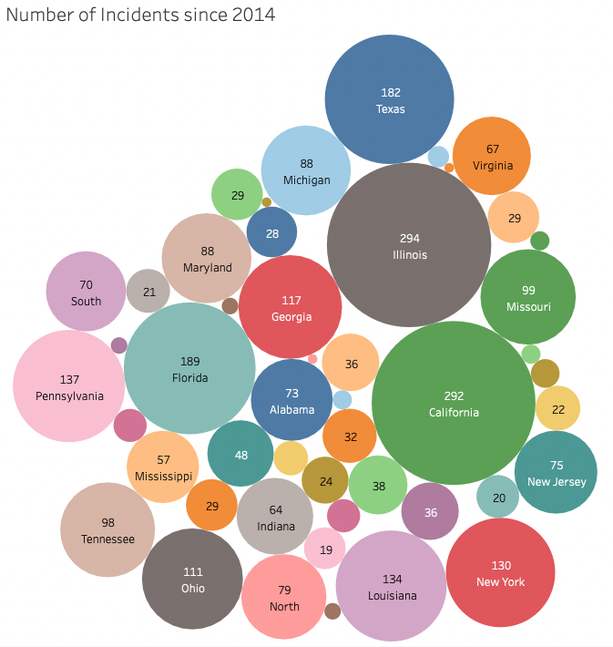
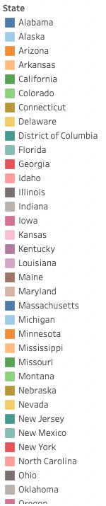
More populous states like California, Texas, Illinois, have highest numbers of gun violence incidents

Slide 11
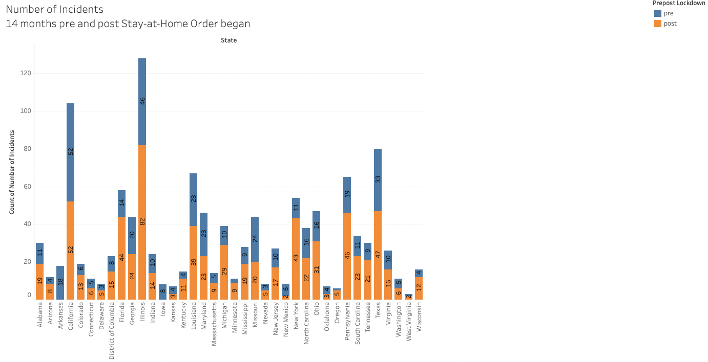
Illinois, Louisiana, New York, Texas, and a few others have higher number of gun violence incidents post Stay-At-Home Mandates versus the pre

Slide 12
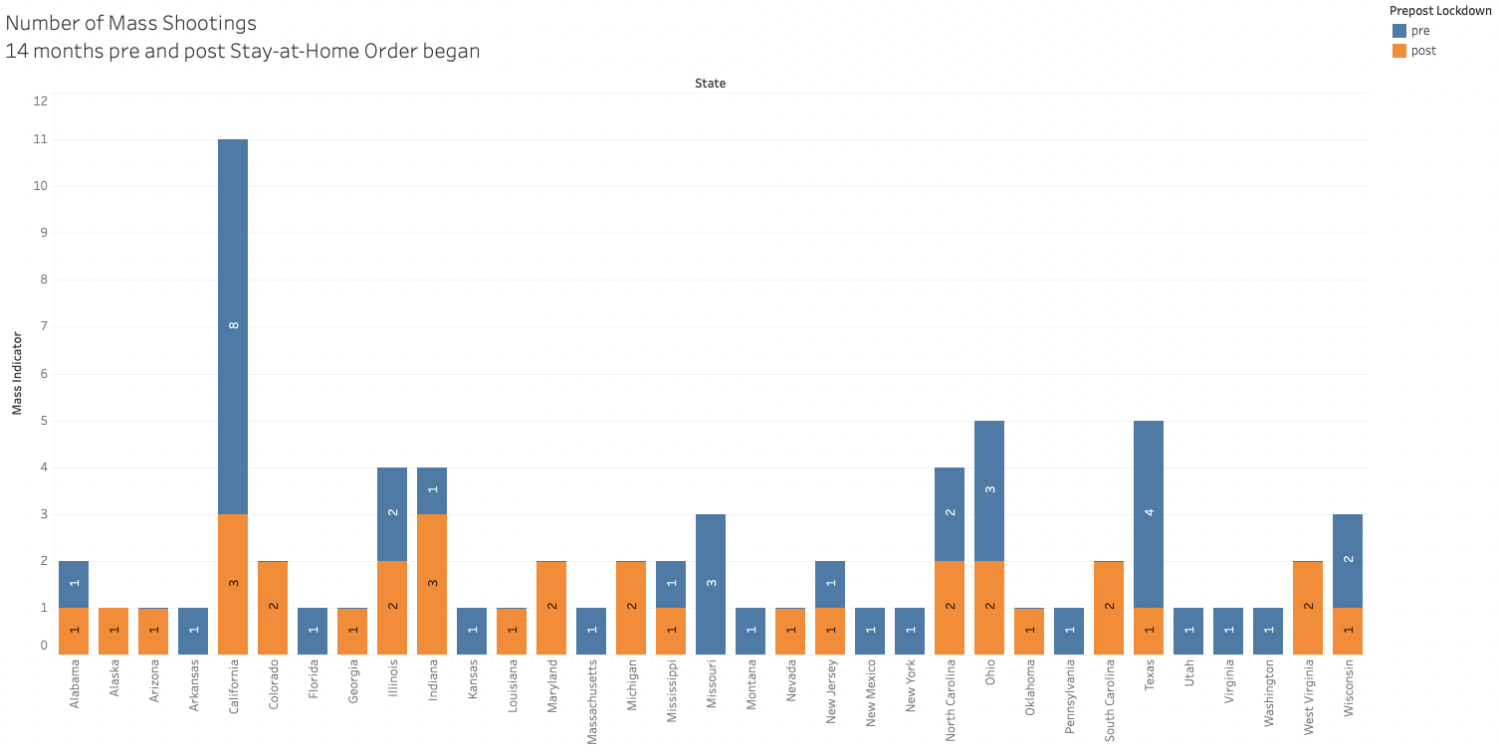
Only Indiana shows more mass shootings in the months post Stay-At-Home Mandates versus pre

Slide 13
Statistical Analysis Methods & Results
Questions, Code, & Results

Slide 14
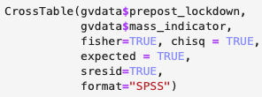
Methods
QUESTION: Do the number of incidents change before lockdown orders versus after lockdown orders?
Code
McNemar Chi-Square Test
IV two timepoints of pre-COVID19 Lockdown and post (Stay-At-Home Start Dates)
DV two levels of incidents being a mass shooting or not
Notes:
We used a McNemar Chi-Square Test with IV being the two timepoints of pre-COVID19 Lockdown and post. Specifically, we use the date of each state for when the Stay at Home orders came into effect as the day that separates pre-pandemic days and "post", while technically still in the pandemic. As for the dependent variable, it is the two levels of the incidents being a mass shooting or not.

Slide 15
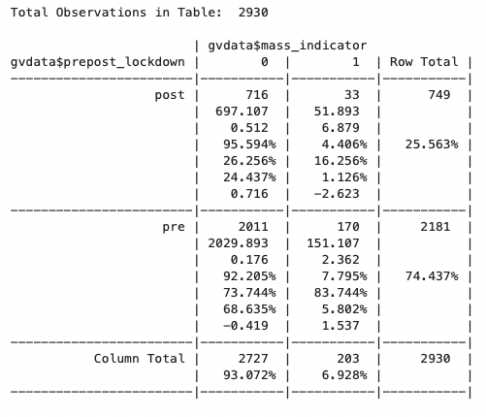
Results
p = 0.001627181
Lockdown mandates make a statistically significant difference in number of gun violence
Data on pre pandemic data dates back to 2014, misleading number of percentage
We see that the standardized residual for post-pandemic incidents that are marked as a mass shooting (-2.623) is significantly different, specifically less (since it's negative), than what is expected.
Notes:
### Check Assumption of Expected Frequencies
All expected values are greater than 5.
### Interpret Results
The results are shown at the bottom of the output, under the heading Pearson's Chi-squared test. Since the p value is less than .05, this analysis is significant, meaning that the changes brought about the pandemic's lockdown mandates have in fact made a difference in the number of gun violence incidents. NOTE: DATA PRE PANDEMIC DATES BACK TO 2014 WHEREAS THE POST DATES ONLY GO UP TO MAY 2021. THIS MAY HAVE AN EFFECT IN THE OUTCOME.
### Post Hoc
We see that the standardized residual for post-pandemic incidents that are marked as a mass shooting (-2.623) is significantly different, specifically less (since it's negative), than what is expected.

Slide 16
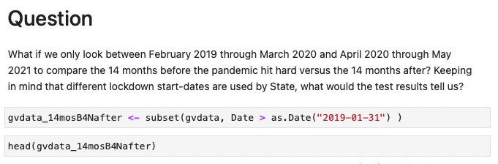
Subset the Data

Slide 17
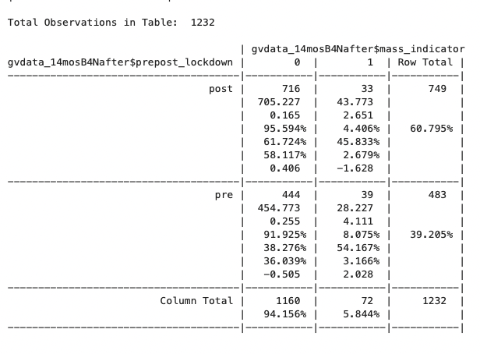
Results
p = 0.007362594
Again - Lockdown mandates make a statistically significant difference in number of gun violence
We see that the standardized residual for post-pandemic incidents that are marked as a mass shooting (-1.628) is significantly different, specifically less (since it's negative), than what is expected.
Once again, it is important to note that the lockdown dates differ from State to State and that a few States did not implement any lockdown or Stay-At-Home mandates.
Notes:
### Check Assumption of Expected Frequencies
Once again, all expected values are greater than 5.
### Interpret Results
The results are shown at the bottom of the output, under the heading Pearson's Chi-squared test. Since the p value is less than .05, this analysis is significant, meaning that the changes brought about the pandemic's lockdown mandates do make a difference in the number of gun violence incidents. We see that the number of total incidents is higher for post versus pre. However, the number of mass shootings is slightly lower for post than pre.
### Post Hoc
We see that the standardized residual for post-pandemic incidents that are marked as a mass shooting (-1.628) is significantly different, specifically less (since it's negative), than what is expected.
Once again, it is important to note that the lockdown dates differ from State to State and that a few States did not implement any lockdown or Stay-At-Home mandates.

Slide 18
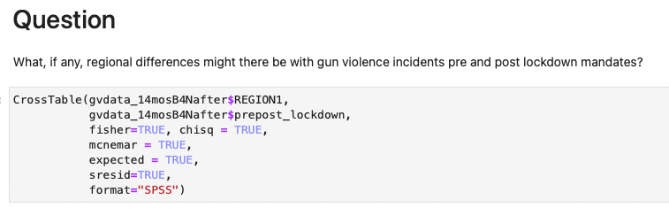
Methods

Slide 19
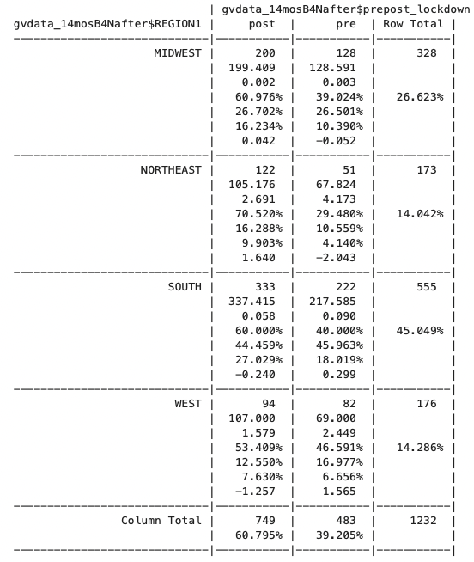
Results
p = 0.01148584
Statistically significant difference among regions, pre vs post pandemic lockdowns in gun violence
Nearly 45% of gun violence incidents are from the SOUTH region
Notes:
### Interpret the results
With p-value less than 0.05, there is significant difference among the regions, pre pandemic and throughout the pandemic. Note that again, there are more gun violence incidents post lockdown mandates versus pre lockdown mandates. Also note that nearly 45% of mass shooting incidents are from the SOUTH region. This may be worth looking into more.

Slide 20
Summary
When we ran the Chi Square with the sub-setted data, we saw significant difference between pre and post stay-at-home orders.
When we compared regions, we saw more gun violence in the south than in the north of the US.
Step 1 Run Chi Square for all data
Step 2 Run Chi Square for a subset of the data
Step 3 Compare among Regions

Slide 21
Conclusion
Gun violence saw a significant uptick after the stay-at-home orders during Covid 19

Slide 22
Questions we are left with
In areas where gun-violence has gun up, has there been any change in the rate of mental illness cases?
In areas where gun-violence has stayed the same or gone down, has there been any change in the rate of mental illness cases?
In areas where gun-violence has gun up, have there been any changes in policing laws or policies?
In areas where gun-violence has stayed the same or gone down, have there been any changes in policing laws or policies?
How can we incorporate population differences to see if gun violence and mass shootings occur more frequently in certain States/Regions?
What could be causing the phenomena in mass shootings in the United States and how does it compare to other countries?
What other ripple effects could the Covid-19 pandemic have on gun violence?
What can be analyzed, if any, as effective ways to reduce gun violence?

Slide 23

Questions

